Slide 1
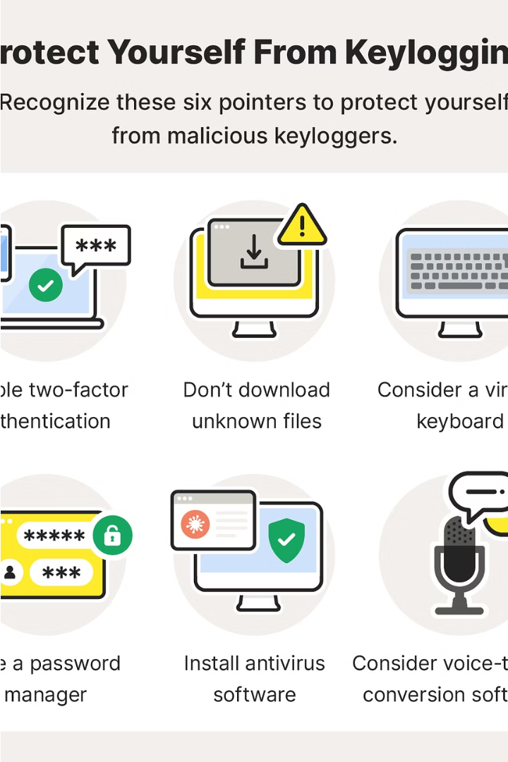
Introduction to Keyloggers
Keyloggers are software tools that record a user's keyboard input, including passwords, credit card numbers, and other sensitive information. They can be used for both legitimate and malicious purposes, making them a powerful but controversial technology.
by SRINIVAS KOMMIRISETTY
GitHub URL: GitHub Project URL

Slide 2
Problem Statement
Create a powerful and secure keylogger software that effectively captures keystrokes on a target system, while also applying strong encryption and access controls to prevent unauthorized access to the captured data, ensuring privacy and integrity.

Slide 3



Understanding Keyloggers
Definition
Operation
Detection and Removal
A keylogger is a software or hardware tool that records every keystroke made on a computer, including passwords, credit card numbers, and other sensitive information.
Keyloggers can be installed surreptitiously to monitor user activity without their knowledge or consent, posing a serious threat to privacy and security.
While some keyloggers can be difficult to detect, there are various anti-keylogging tools and methods available to identify and remove them from a system.

Slide 4



Keyloggers and Privacy Concerns
Privacy Invasion
Security Vulnerabilities
Data Protection
Keyloggers pose a serious threat to individual privacy by capturing every keystroke, potentially exposing sensitive information like passwords, personal messages, and financial data.
Keyloggers can be used by hackers to gain unauthorized access to systems and accounts, leading to identity theft, financial fraud, and other security breaches.
The use of keyloggers raises ethical concerns around consent, data ownership, and the need for robust data protection policies to safeguard user privacy.

Slide 5
Keyloggers and Cybersecurity
Threat Detection
Vulnerability Exploitation
Incident Response
Keyloggers pose a significant threat to cybersecurity, as they can record sensitive information like login credentials, credit card numbers, and confidential data.
Detecting and responding to keylogger incidents is crucial for organizations to mitigate the impact of data breaches and protect their assets.
Cybercriminals often leverage keyloggers to gain unauthorized access to systems and networks, exploiting security vulnerabilities to steal valuable data.

Slide 6
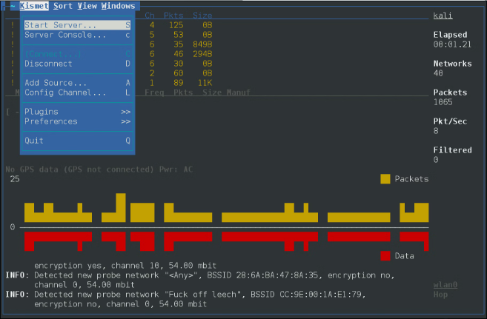
Keyloggers in Linux
Linux, the powerful open-source operating system, offers a robust and versatile platform for developing keyloggers. Leveraging the flexibility of Linux, cybersecurity professionals and developers can create sophisticated keylogging tools to monitor user activities and enhance system security.
Linux-based keyloggers provide advanced features such as stealth operation, remote access, and customizable logging capabilities, making them invaluable for security testing and incident response.

Slide 7
Python and Keyloggers
Powerful Integration
Event-Driven Logging
Stealth and Evasion
Customization and Automation
Python's versatility makes it an excellent choice for developing keylogging applications. Its robust libraries and cross-platform compatibility allow for seamless integration with various operating systems, including Linux.
Python's event-driven programming model is well-suited for capturing and logging keyboard events in real-time. Developers can leverage powerful libraries like pynput to monitor keyboard input and record user activity.
Python's ability to create compact, executable programs enables the development of stealthy keyloggers that can operate in the background without drawing attention. Techniques like code obfuscation and runtime optimization can further enhance the keylogger's covert nature.
Python's extensive ecosystem of libraries and frameworks allows for the creation of highly customized keyloggers with advanced features, such as remote access, email notifications, and automatic data exfiltration.

Slide 8
Building a Keylogger with Python
Import Libraries
1
Start by importing the necessary Python libraries for keylogging functionality.
Capture Keystrokes
2
Develop a script to continuously monitor and record user's keystrokes.
Log to File
3
Store the captured keystrokes in a log file for later analysis.
Add Features
4
Enhance the keylogger with additional features like email alerts and screenshots.
Building a keylogger with Python involves a series of steps, from importing the required libraries to capturing keystrokes, logging them to a file, and adding advanced features like email alerts and screenshots. This allows you to create a powerful and customizable keylogging tool for various security and monitoring purposes.

Slide 9
Keylogger Features and Functionality
1
Keystroke Capture
2
Screenshot Capture
Keyloggers can record every keystroke made on the target device, including passwords, messages, and other sensitive information.
Advanced keyloggers can take periodic screenshots, providing a visual record of the user's activity.
3
Stealth Mode
4
Remote Access
Keyloggers can operate in complete stealth, hiding from the user and evading detection by security software.
Many keyloggers allow remote access, enabling the attacker to view the captured data from a separate location.

Slide 10




Keylogger Deployment and Usage
Delivery Methods
Keyloggers can be deployed through various means, such as physical installation on a target device or remote distribution via email attachments or malicious downloads.
Stealth Operation
Advanced keyloggers employ sophisticated techniques to remain undetected, including hiding in system processes, utilizing encrypted communications, and mimicking legitimate software.
Data Collection
Keyloggers silently record user input, including keystrokes, passwords, and sensitive information, storing the data for later retrieval or transmission to the attacker.

Slide 11



Ethical Considerations and Conclusion
Keyloggers are powerful tools, but their use raises important ethical concerns. It's crucial to ensure that they are deployed ethically and legally, respecting user privacy and consent.
Ethical Use
Legal Compliance
User Responsibility
Keyloggers should only be used for legitimate purposes, such as monitoring employee productivity or securing sensitive information. Their misuse can violate privacy rights.
Carefully review relevant laws and regulations before using a keylogger, as its deployment may be restricted or require user consent in certain jurisdictions.
Keylogger users have a moral and legal obligation to protect the privacy and security of the individuals whose actions are being monitored.
In conclusion, keyloggers are powerful tools that can enhance cybersecurity and productivity, but their use must be balanced with ethical considerations and legal compliance. With responsible deployment, keyloggers can be valuable assets while respecting user privacy and consent.

Slide 12
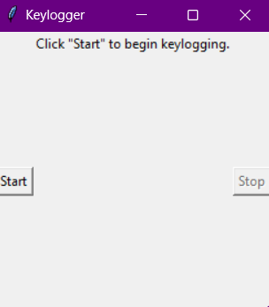

Output

Slide 13

Output

Slide 14
Project Link:
https://github.com/srinivas2200030391/APSSDC-Project

